Slide 1
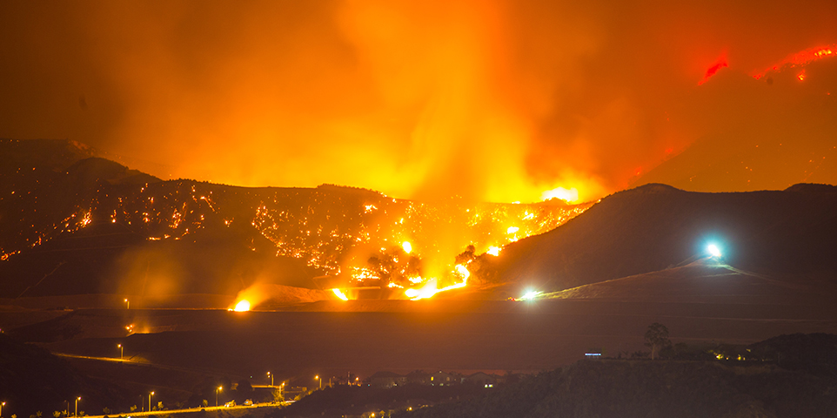
Insights into Wildfires in the United States (1994-2009)
A presentation by: Areej, Isaac, Justin, & Sandra.

Slide 2
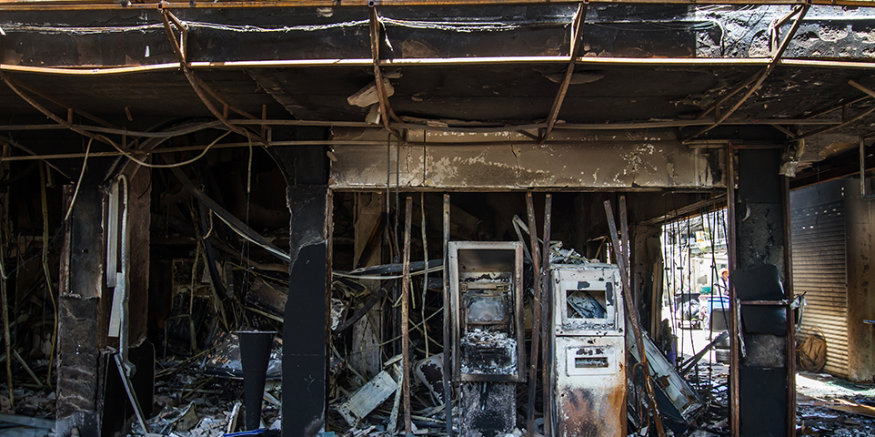
Project Scope:
To visualize the trend for all the wild fires in the United States over a period of 15 years.
The causes of these wild fires in each state.
Research Questions to Answer:
Are wildfires on the rise in the United States?
Does Global Climate Change effect the spread of the wildfires all over the Unites States?
Does the damage of wildfires have an impact on the economy of the United States?

Slide 3
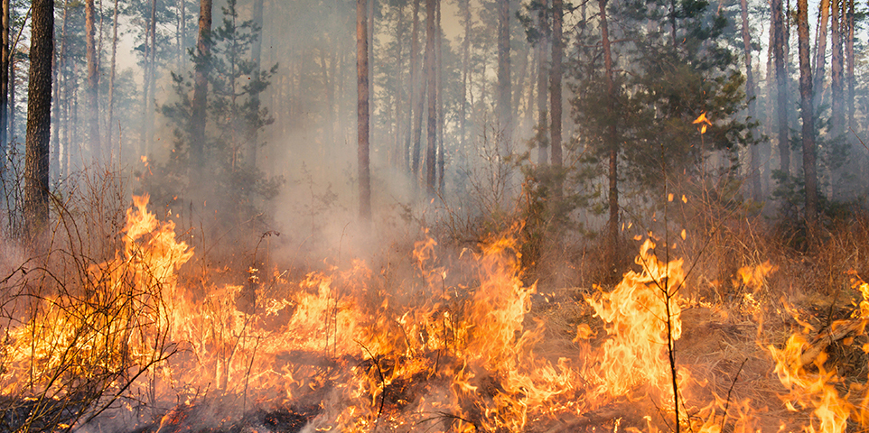
Data Sets to be Used:
Data for this study is obtained from Kaggle.com. This database is a spectacular collection of data on wildfires in the United States from 1994 to 2009 created to support the US Fire Program Analysis. It has data on over 1 billion wildfires over this time period.
Link: https://www.kaggle.com/rtatman/188-million-us-wildfires

Slide 4
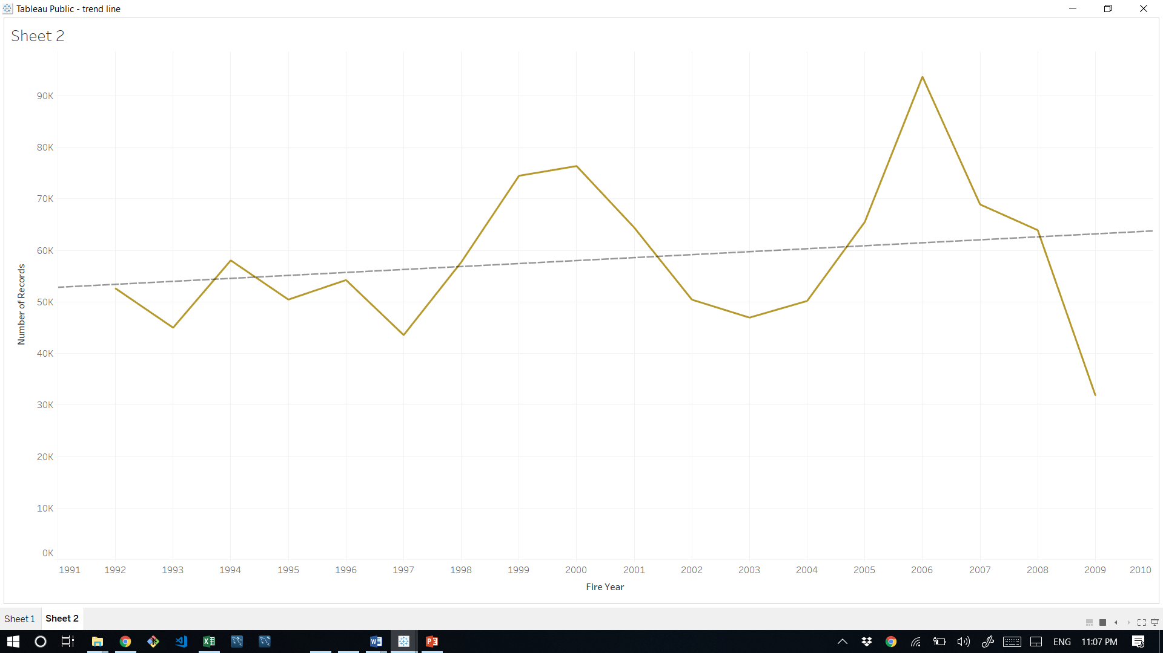
The trend:
The number of fires per year ran between 45,000 and 100,000. There was a spike in fires in 2006 to more than 100,000. There is a small upward trend during this time period.

Slide 5
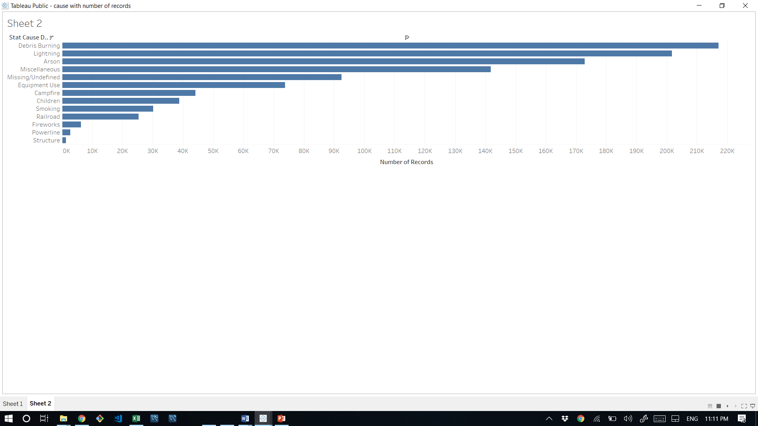
Causes:
Debris burning was the largest cause of wildfire by a significant margin.

Slide 6
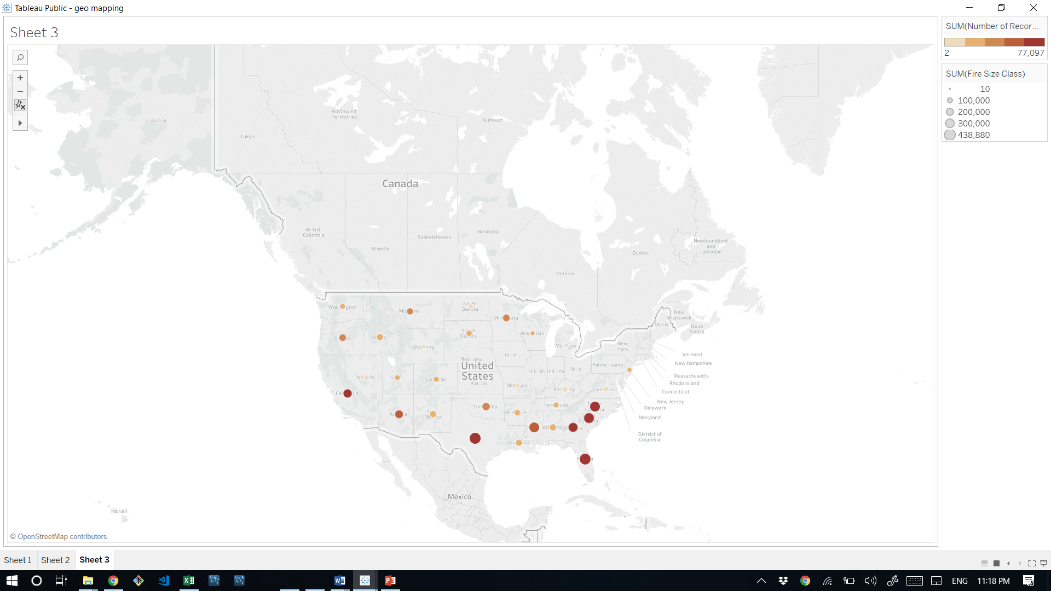
Fire size per state

